Slide 1
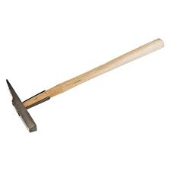
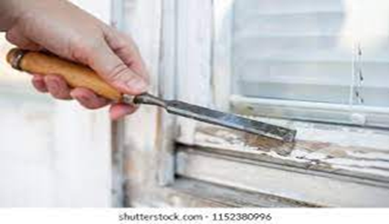
Glazing Maintenance
Basic Glazing Tools
1. Glazier Hammer
- It is used for tapping on glass and window frame to ensure a secure and perfect fit .
2. Putty Chisel
-It is used for removing putty on the window frame or sashes.

Slide 2
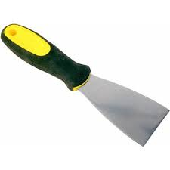
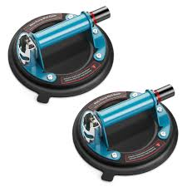
3. Window Scrapers
- It is used for removing stubborn materials from glass surfaces.
4. Glass Suction Cup
- It is used for lifting, moving and position glass panels with ease.

Slide 3
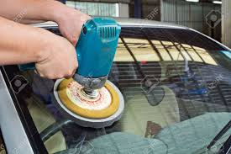
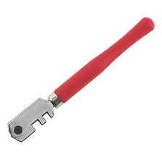
5.Glass polishers
- It is used to get scratches out of glass.
6. Glass cutter.
- It is used for cutting glass.

Slide 4
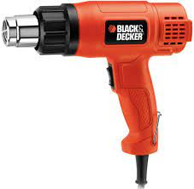
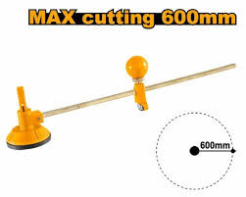
7. Glass Gun
- It is used to plant nails to hold the place in place .
8. Glass Compass
- It is used for circular cuts.

Slide 5
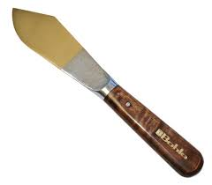
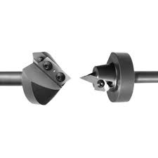
9. Putty Knife
- It is used to work putty around the edges of each panel of glass.
10. Glass Drilling Bits
- It is used for drilling holes through hard materials like glass, masonry, stones etc.

Slide 6
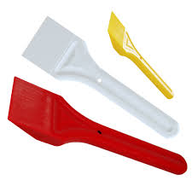
Basic hand tools
11.Glass Shovel
- It is used to hold the paddle against your glazing beads and tap them in position.
Video :
https://youtube.com/shorts/rwLOu5rCNEM?si=uvWGhqBb7OFmIsKI
Feedback : Activity

Slide 7




Kwa Thema Skills School
Subject : Maintenance Marks : 10
Grade : Year 1 Time : 30 mins
Date : / / 2024
Question:1
1.Name the following hand tools that are used in glazing.
1.__________________ 2.____________________
3.___________________ 4. ____________________

Slide 8
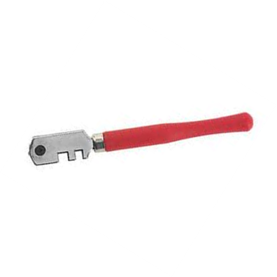





5. _________________ 6. ____________________
7. __________________ 8. ___________________
9. __________________ 10. ___________________
(10)

Slide 9
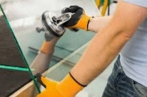
Feedback : Activity
(Practical lesson or Project)
Glazing

